Slide 1



K.RAMAKRISHNAN COLLEGE OF TECHNOLOGY (AUTONOMOUS), TRICHY
REAL-TIME FACE DETECTION AND RECOGNITION
PRESENTED BY:
2303811724322075 - NANDHINI K
DEPT: AI&DS - 'B'

Slide 2
PRESENTATION OVERVIEW
Problem Identification
Objective
Block diagram of proposed system
Data structures used
Advantages of proposed system
Module Describtion
Module Implementation
Source Code
Screenshot
Conclusion and Future Enhancement

Slide 3
PROBLEM IDENTIFICATION
Traditional authentication methods like passwords and PINs are prone to theft, sharing, and hacking. Real-time face detection and recognition addresses this by providing a secure, non-intrusive, and reliable way to prevent unauthorized access while ensuring quick and efficient authentication.

Slide 4
OBJECTIVE
To create a real-time face detection and recognition system that enhances security by providing a reliable and non-intrusive authentication method, addressing the vulnerabilities of traditional systems.

Slide 5
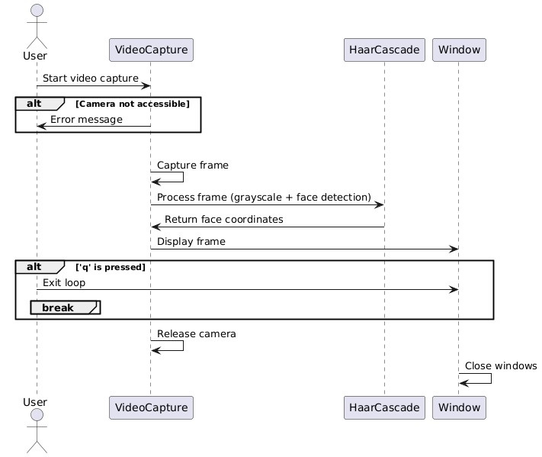
PROPOSED SYSTEM

Slide 6
MACHINE LEARNING USED
HAAR CASCADE CLASSSIFIER :
A Haar Cascade Classifier is a machine learning-based approach used for object detection, most commonly for detecting faces. It was introduced by Paul Viola and Michael Jones in their 2001

Slide 7
ADVANTAGES OF PROPOSED SYSTEM
Advantages of the face detection system:
1. Real-Time Face Detection: The system provides live face detection using the webcam, which is useful for applications like security monitoring, attendance tracking, or interactive systems.
2. Cost-Effective and Efficient: Leveraging Haar Cascade classifiers in OpenCV offers a low-cost, efficient solution for face detection without requiring high-end hardware or complex algorithms.
3. Scalability and Integration: The system can be expanded to work with multiple cameras or integrated into larger applications, such as security systems or user authentication systems.

Slide 8


Modules
1. OpenCV (cv2)
2. cv2.rectangle
3.cv2.putText
4. cv2.imshow
5. cv2.waitKey

Slide 9
Module Description
1. OpenCV (cv2)
Purpose: A powerful library for computer vision tasks like image processing, video capturing, and face detection.
Role: It enables video capture from the webcam, face detection, and image manipulation (like converting to grayscale and drawing rectangles).
2. cv2.rectangle
Purpose: Draws geometric shapes (rectangles, circles) on images.
Role: It draws rectangles around detected faces, visually highlighting them in the video frame.
3. cv2.putText
Purpose: Adds text to an image or video frame.
Role: Labels the detected faces with the word "Face" near the top of the rectangle for easier identification.

Slide 10
Module Description
4. cv2.imshow
Purpose: Displays images or video in a window.﻿
Role: It shows the video feed with face detection annotations (rectangles and labels), providing real-time feedback to the user.﻿
5. cv2.waitKey
﻿
Purpose: Waits for a key press event, used for controlling program flow.﻿
Role: It pauses the program until a key is pressed, allowing the program to exit when "q" is pressed.

Slide 11
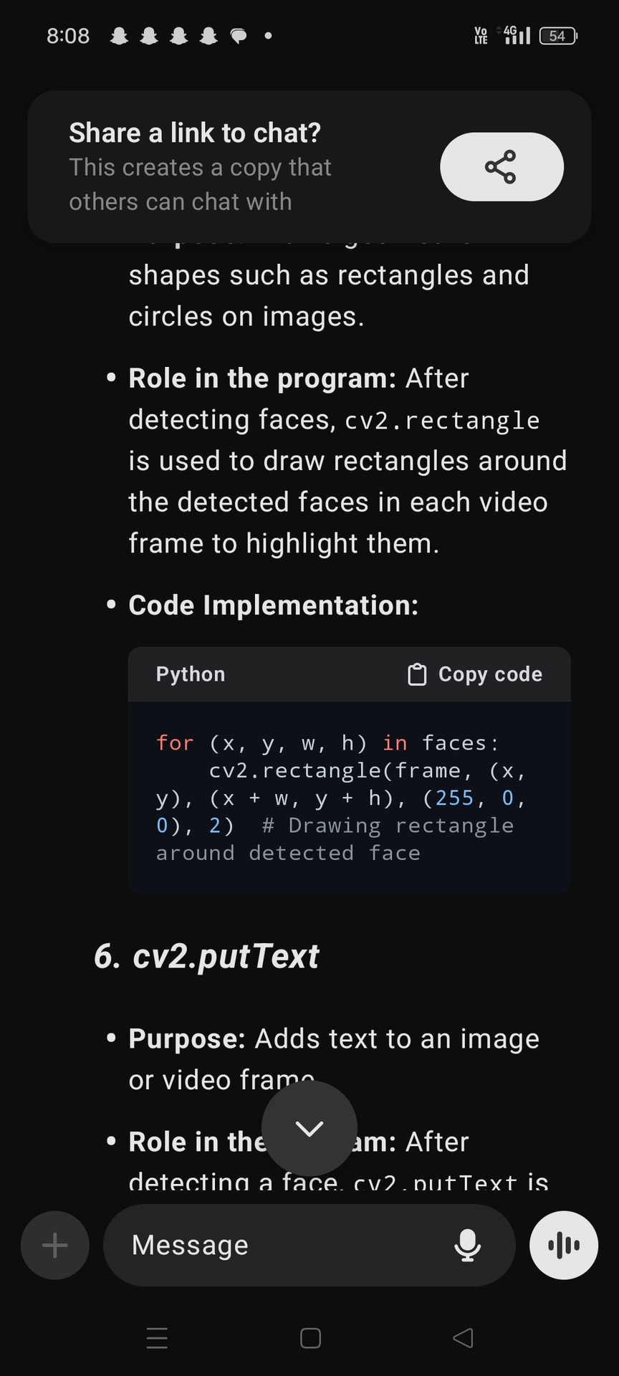
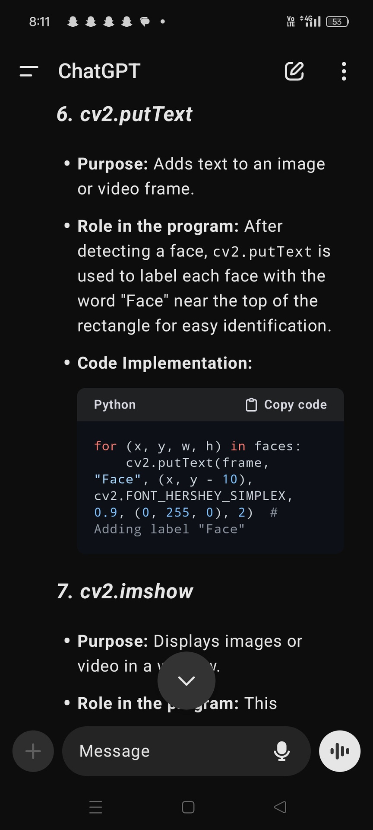
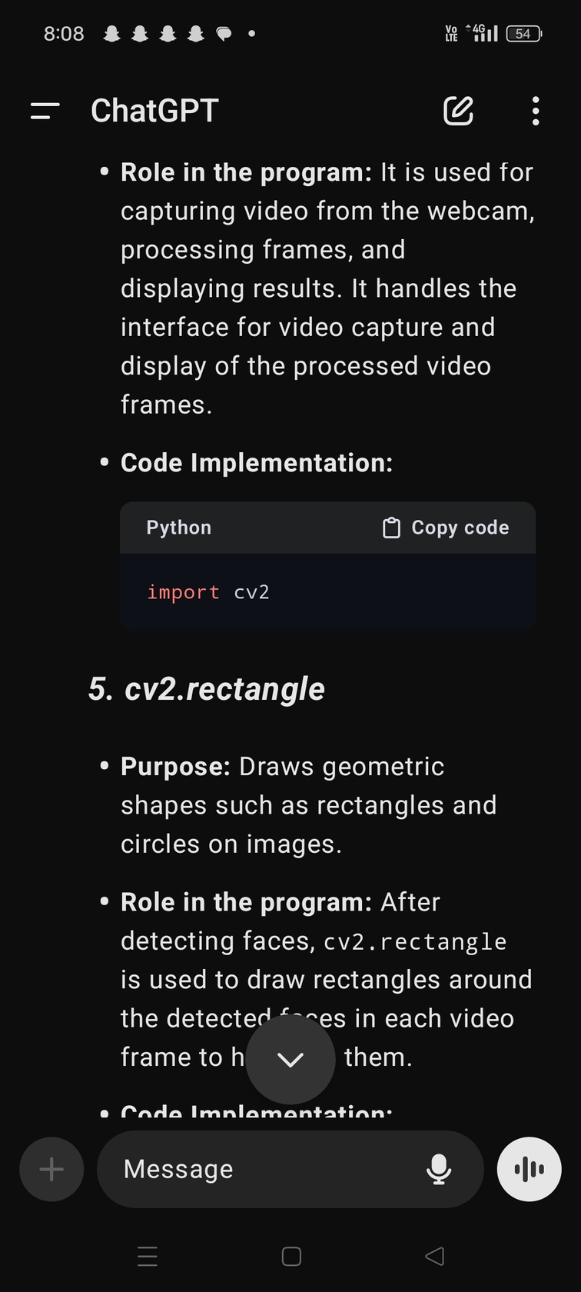
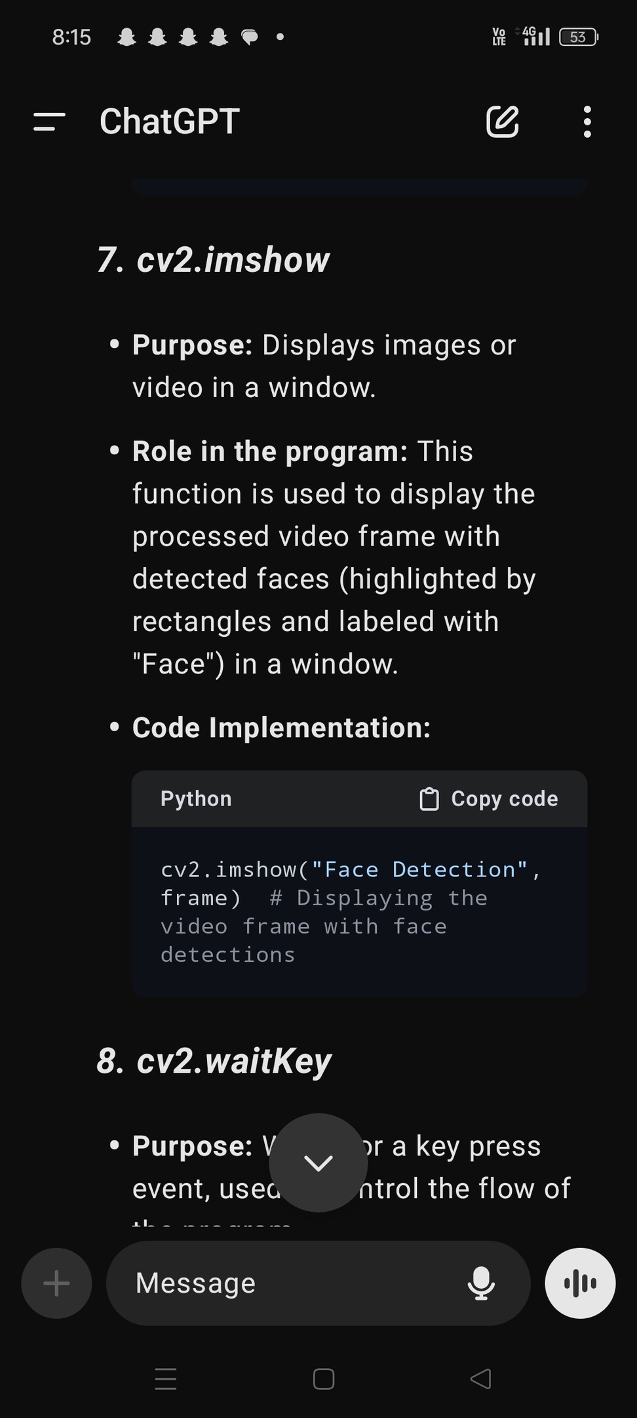

Module Implementation
1. OpenCV (cv2) :
2.cv2.rectangle:
3. cv2.putText:
4. cv2.imshow:
5. cv2.waitKey:

Slide 12
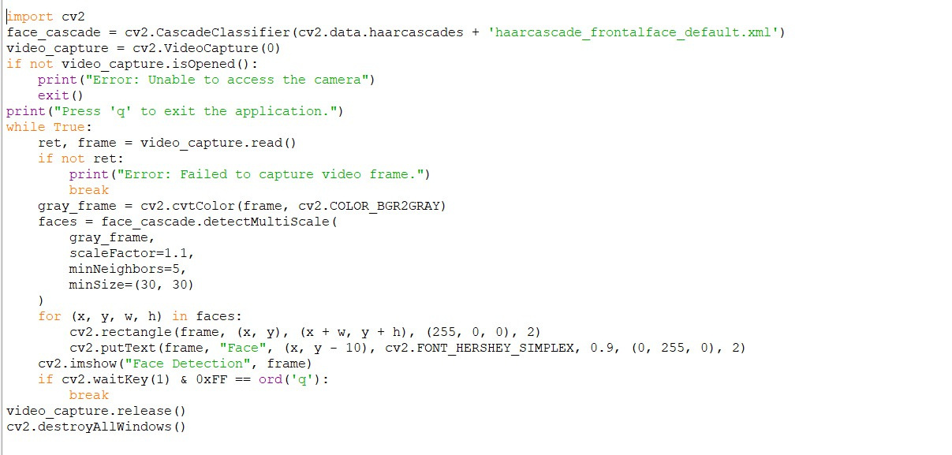
Source Code

Slide 13
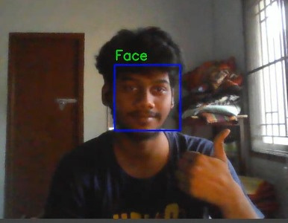
Screenshot
Output

Slide 14
Conclusion and Future Enhancement
Conclusion:
The Real-Time Face Detection and Recognition program successfully uses OpenCV to detect and display faces from webcam video in real time. It offers a reliable and non-intrusive solution for applications such as security, attendance, and authentication, demonstrating the potential of facial recognition for automated systems.
Future Enhancement :
Multi-Face Detection: Enable detection and recognition of multiple faces.
Privacy Enhancements: Encrypt face data to ensure better security and privacy
3D Face Detection: Detect faces from different angles for improved accuracy

Slide 15
THANK YOU

